Slide 1
Welcome to Bradnerville!!!
*established 1998

Slide 2
Quote of the Day:
“Tip for the 1st day of school: If you check out all of the books in a library, you can start your own library…”

Slide 3
Meet the King of Bradnerville…
(The guy, not the fish…)

Slide 4
About me:
21st year teaching
Married 4 years ago
My daughter, Maddie, is a freshman in college
I have two dogs – Barney, and Sprinkles (yes, Sprinkles…)
What do I do when I’m not teaching?
Fishing
Biking
Hiking
Hoarding (just look around you – I obviously have a problem…)

Slide 5
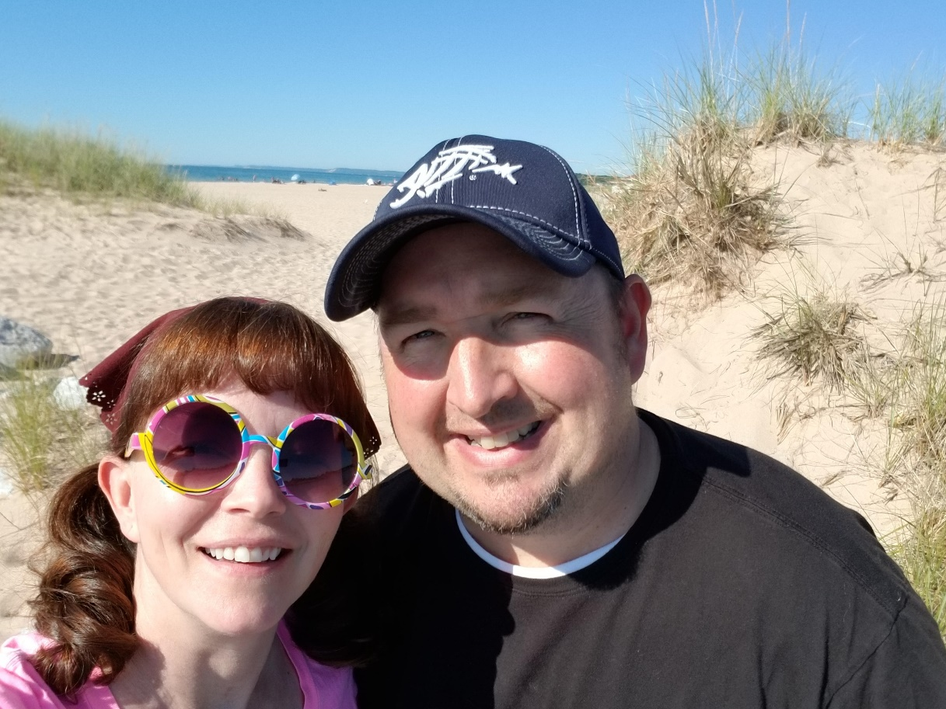
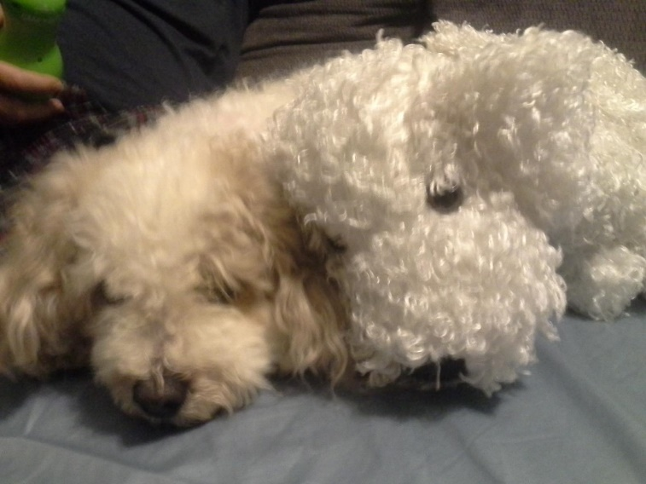

Slide 6
My Education:
University of Michigan (bachelors degree in Anthropology)
Eastern Michigan University (bachelors degree in English and History)
Marygrove College (master’s degree in The Art of Teaching)

Slide 7
Why I became a teacher:
Grandpa Bradner was the founding president of Schoolcraft College
Dad taught for nearly 40 years
I walked into 8th grade SS, and I met Ms. Boltz…

Slide 8
My Classroom Webpage:
www.historyaccordingtobradner.com
***All assignments, handouts, and necessary materials (textbook pages, etc.) can be found there
***Updated daily

Slide 9
What do you do if you miss a day of school?
You have 2 choices:
When you return, go to the “What Did I Miss?” board in the classroom
Visit my website: www.historyaccordingtobradner.com
***Please bookmark this site in your cellphone

Slide 10
My Tardy Policy:
When the bell rings, you need to be in your seat. If you’re not, you’re late. Phone call home after 3, tardy referral on your 4th.

Slide 11
At the end of the hour:
The bell does not dismiss you, the King does!!!
If you want to leave on time, everyone needs to be in their assigned seats!

Slide 12
History Notebooks:
You need a single-subject notebook for this class
We use these notebooks as an organizational tool for each unit
You must have yours no later than next Tuesday (9/4)
***Please write this in your planners

Slide 13
Homework:
From now on, we’ll call it “homefun” instead
If you take advantage of the time provided in class, you won’t have much of it. If you don’t, you will (and I’ll be contacting home to talk to mom/dad about it)
Homework assignments are only worth 3pts each and are graded on completion only (see rubric posted on cabinet)
Any assignment can be turned in late (‘til the last day of the quarter), but only for 1/10 of a point
Homefun isn’t busywork – it has a purpose. Please do yours every day!!!
If zeros become a habit for you, I’ll be communicating with home

Slide 14
Snacks:
You can bring snacks to class
You can bring water to class
These are privileges -- if either becomes a distraction, or if litter becomes a problem in Bradnerville, these privileges will be lost

Slide 15
Cell Phones:
We all love ‘em, but they must be off and away in this class
I won’t be on mine either
If there is some emergency at home, your parent will contact the office, and they will find you and relay the message

Slide 16
Lost-and-Found
Located on the file cabinets next to the old radio
If not claimed within a week, I’ll move things to the school lost-and-found downstairs

Slide 17
Passes…
You get three (3) per quarter
You need your planner to use one
If you need to leave this class, and you don’t have your planner, it will be a lunch detention
***If you lose your planner, new ones can be purchased in guidance

Slide 18
“Quality Work”:
This is your job. You’ll get out of school what you put into it.
Part of my job is to prepare you for high school, so I won’t accept garbage or sub-eighth-grade-quality work from you
“Quality Work”…
is complete
is neat and easy to read
identifies the author
identifies the assignment (has a title)
reflects 100% effort

Slide 19
Expectations:
Bring all needed materials to class
Remain in seat during instructional time
Keep hands, feet, and other objects to yourself
Be respectful (to self, others, and property)
Follow directions the first time they are given

Slide 20
What are your expectations of me?

