Slide 1
The Temperance Movement

Slide 2
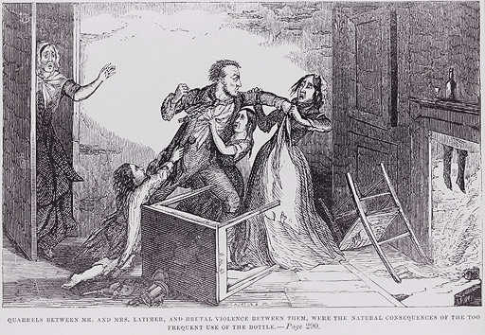
Alcoholism rates in the 1800’s were extremely high. Many alcoholics abused their families.

Slide 3
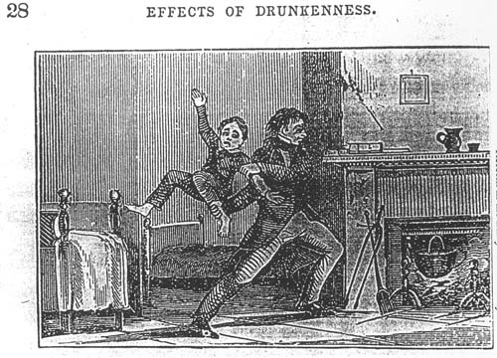

Slide 4
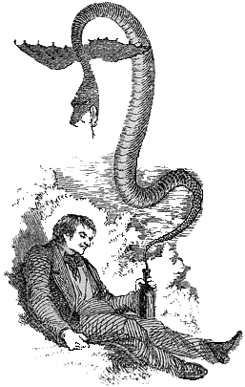
Look at the strong symbolism here…

Slide 5
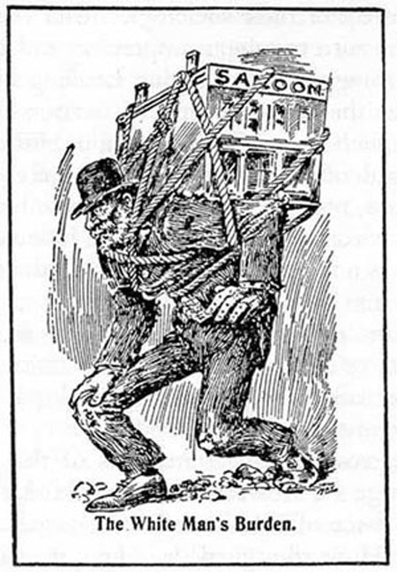

Slide 6
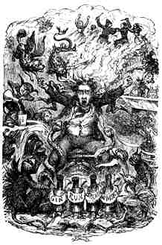
This cartoon portrays the never-ending struggle faced by those with alcohol addictions

Slide 7
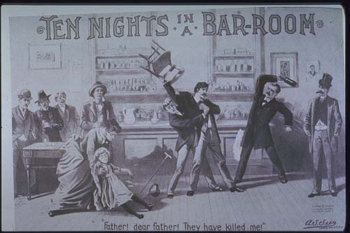
Alcohol-related violence wasn’t just in peoples’ homes. Often, innocent bystanders were hurt.

Slide 8
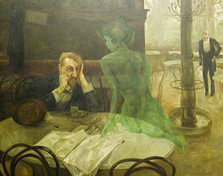
An amazing painting portraying the constant temptation faced by alcoholics. An agonizing decision faced daily by those trying to overcome alcoholism.

Slide 9
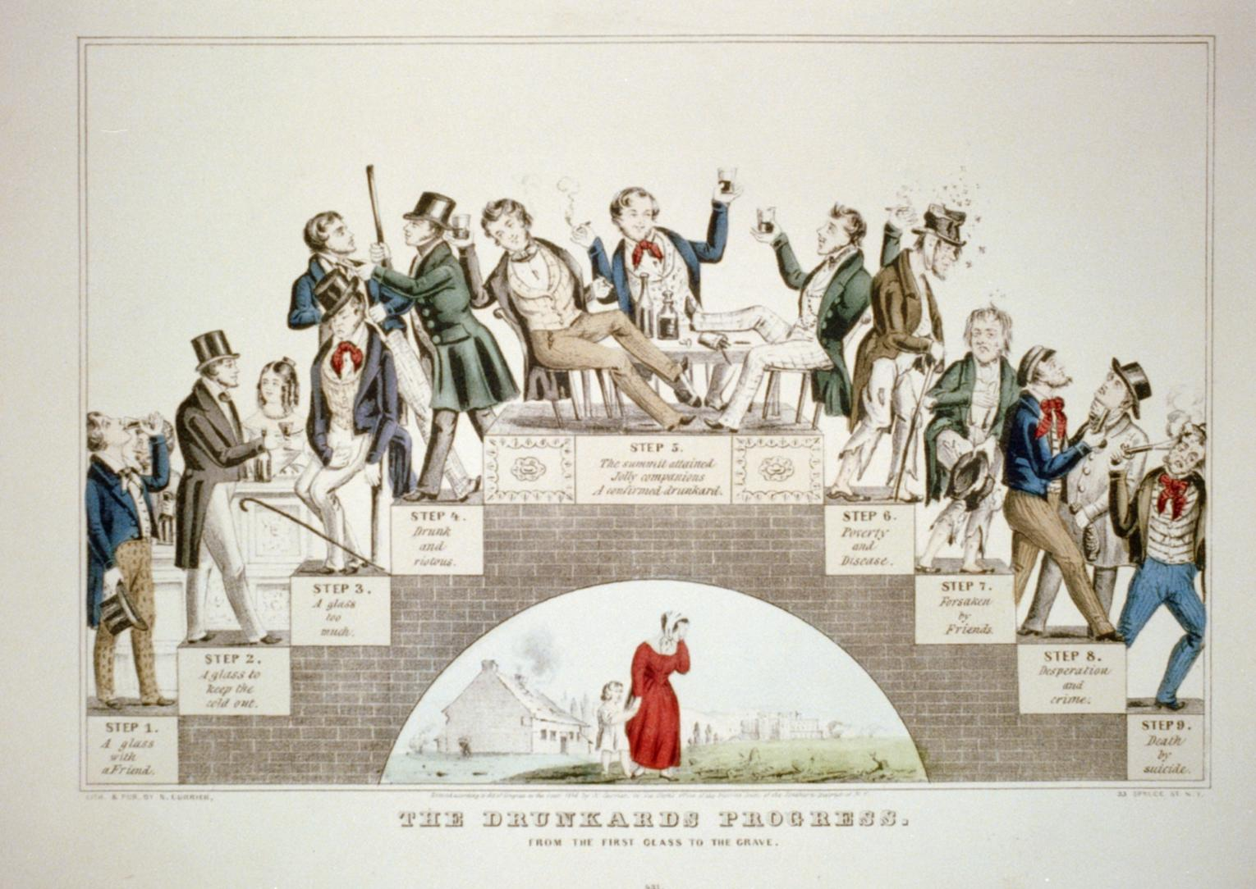

Slide 10
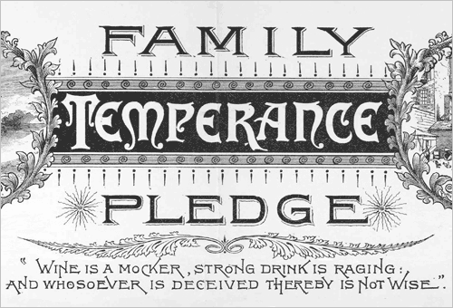

Slide 11
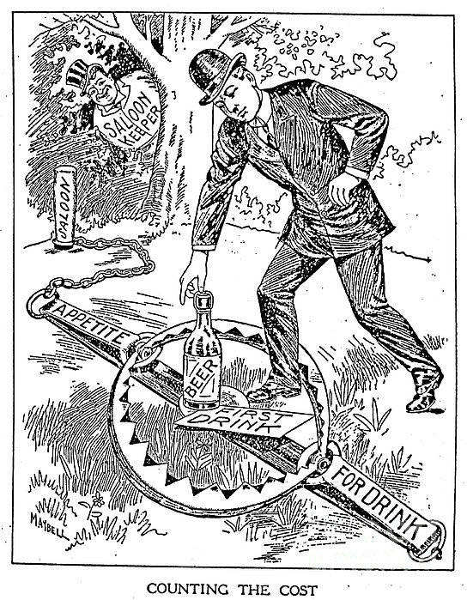
More great symbolism here…

Slide 12
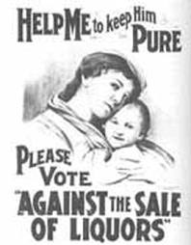
Temperance Movement Poster

Slide 13
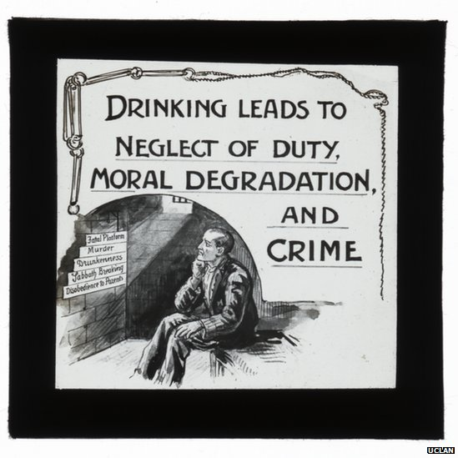
Temperance Movement Poster #2

